Slide 1
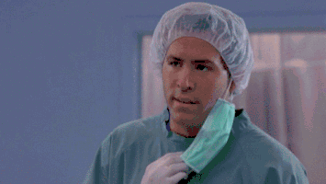
WHY?

Slide 2
Vragen maken
Op 3 verschillende manieren:

Slide 3
1.
Met to be to have of een hulpwerkwoord | Are you okay? Have you got a book? Can you fly?

Slide 4
2.
Met do, Does (bij he,she,it)of Did (verleden tijd) | Do you understand? Does she love him? Did he kill him?

Slide 5
3!
Met vraagwoorden | Who did she kill? What is he eating? How does he sleep? Where will we sleep? Why did he go there? Which dog is sweet? When did I do that?

Slide 6
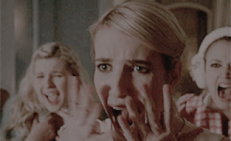
HOWEVER!

Slide 7
van stellende zin vraagzin
Bij werkwoorden ZIJN (be), HEBBEN (have) en HULPWW (can, may, might, will)
He is crazy | Is he crazy?
She has got a dog | Has she got a dog?
I can fly | Can I fly?
Bij elk ander ww:
You understand | Do you understand?
You like dogs. | Do you like dogs?
He loves cats. | Does he love cats?
She hates spiders. | Does she hate spiders?

Slide 8
I destroy homework ---->
He loves soccer ---->
We’ve got two dogs ---->
Peter is a murderer ---->
Vinny was in prison ---->
Let op de /s/!
Does he like soup? ---->
Who likes sharks? ----> (we)
Do I love eating? ---->

Slide 9
I destroy homework ----> Do I destroy homework?
He loves soccer ----> Does he love soccer?
We’ve got two dogs ----> Have we got two dogs?
Peter is a murderer ----> Is peter a murderer?
Vinny was in prison ----> Was vinny in prison?
Let op de /s/!
Does he like soup? ----> He likes soup
Who likes sharks? ----> (we) We like sharks.
Do I love eating? ----> I love eating.

Slide 10
Schema (zie ander bestand) + oefenen

